Slide 1
Liquid Crystal Display: LCD
What is an LCD (Liquid Crystal Display)?
A liquid crystal display or LCD is a combination of two states of matter, the solid and the liquid.
LCD uses a liquid crystal to produce a visible image. Liquid crystal displays are super-thin technology display screens that are generally used in laptop computer screens, TVs, cell phones, and portable video games.
LCD’s technologies allow displays to be much thinner when compared to a cathode ray tube (CRT) technology.
Liquid crystal display is composed of several layers which include two polarized panel filters and electrodes.
An LCD is either made up of an active matrix display grid or a passive display grid.

Slide 2
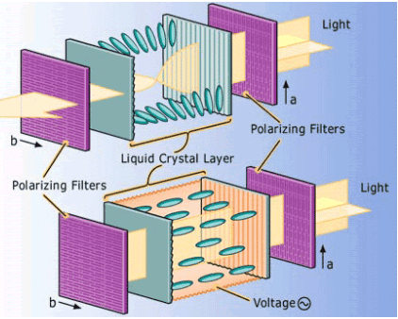
Liquid Crystal Display: LCD
How LCDs are Constructed?
Simple facts that should be considered while making an LCD:
The basic structure of the LCD should be controlled by changing the applied current.
A polarized light must be used.
The liquid crystal should able be to control both of the operations to transmit or can also able to change the polarized light.

Slide 3
Liquid Crystal Display: LCD
How LCDs Work?
The LCD works on the principle of blocking light.
When an electrical current is applied to the liquid crystal molecule, the molecule tends to untwist.
This causes the angle of light which is passing through the molecule of the polarized glass and also causes a change in the angle of the top polarizing filter.
As a result, a little light is allowed to pass the polarized glass through a particular area of the LCD.
Thus that particular area will become dark compared to others.
An electrode plane of indium-tin-oxide which is kept on top and a polarized glass with a polarizing film is also added on the bottom of the device.

Slide 4
Liquid Crystal Display: LCD
Different Types of LCD
Twisted Nematic Display.
In-Plane Switching Display.
Vertical Alignment Panel.
Advanced Fringe Field Switching (AFFS).
Passive and Active Matrix Displays

Slide 5
Liquid Crystal Display: LCD
Twisted Nematic Display
The TN (Twisted Nematic) LCDs used most frequently and used in different kinds of displays all over the industries.
These displays most frequently used by gamers as they are cheap & have quick response time as compared with other displays.
The main disadvantage of these displays is that they have low quality as well as partial contrast ratios, viewing angles & reproduction of color.
But, these devices are sufficient for daily operations.
These displays allow quick response times as well as quick refresh rates.
So, these are the only gaming displays which are available with 240 hertz (Hz).
These displays have poor contrast & color because of the not accurate otherwise precise twist device.

Slide 6
Liquid Crystal Display: LCD
In-Plane Switching (IPS) Display:
IPS displays are considered to be the best LCD because they provide good image quality, higher viewing angles, vibrant color precision and difference.
These displays are mostly used by graphic designers and in some other applications, LCDs need the maximum potential standards for the reproduction of image and color.

Slide 7
Liquid Crystal Display: LCD
Vertical Alignment Panel
The vertical alignment (VA) panels have the best viewing angles as well as color reproduction with higher quality features as compared with TN type displays.
These panels have a low response time.
But, these are much more reasonable and appropriate for daily use.
The structure of this panel generates deeper blacks as well as better colors as compared with the twisted nematic display.
Furthermore, they have slow response times & low refresh rates.

Slide 8
Liquid Crystal Display: LCD
Advanced Fringe Field Switching (AFFS)
AFFS LCDs offer the best performance and a wide range of color reproduction as compared with IPS displays.
The applications of AFFS are very advanced because they can reduce the distortion of color without compromising on the broad viewing angle.
Usually, this display is used in highly advanced as well as professional surroundings like in the viable airplane cockpits.

Slide 9
Liquid Crystal Display: LCD
Passive and Active Matrix Displays
The Passive-matrix type LCDs works with a simple grid so that charge can be supplied to a specific pixel on the LCD.
The grid can be designed with a quiet process and it starts through two substrates which are known as glass layers.
One glass layer gives columns whereas the other one gives rows that are designed by using a clear conductive material like indium-tin-oxide.
The passive-matrix system has major drawbacks particularly response time is slow and inaccurate voltage control.
In this type of display, the simplest way to check the slow response time is to shift the mouse pointer fast from one face of the display to the other.

Slide 10
Liquid Crystal Display: LCD
Advantages:
LCD’s consumes less amount of power compared to CRT and LED.
LCD’s are consist of some microwatts for display in comparison to some mill watts for LED’s.
LCDs are of low cost.
Provides excellent contrast.
LCD’s are thinner and lighter when compared to cathode-ray tube and LED

Slide 11
Liquid Crystal Display: LCD
Disadvantages:
LCD’s Require additional light sources.
Range of temperature is limited for operation.
Low reliability.
Speed is very low.
LCD’s need an AC drive.

Slide 12
Liquid Crystal Display: LCD
Applications
This liquid crystal technology has major applications in the field of science and engineering as well on electronic devices.
Liquid crystal thermometer.
Optical imaging.
The liquid crystal display technology is also applicable in the visualization of the radio frequency waves in the waveguide.
Used in the medical applications.

Slide 13
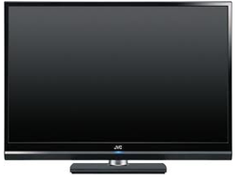
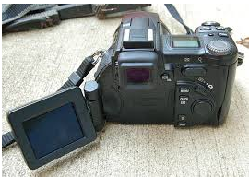
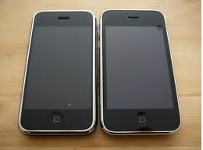
Liquid Crystal Display: LCD
LCD Displays:
LCD Display Camera
LCD Monitor
LCD Display Smart Phone

Slide 14
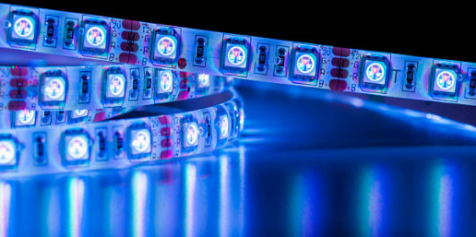
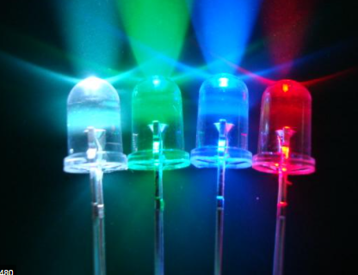
Light-emitting Diode: (LED)
What is a Light Emitting Diode?
A light-emitting diode (LED) is a semiconductor device that emits light when an electric current flows through it.
When current passes through an LED, the electrons recombine with holes emitting light in the process.
LEDs allow the current to flow in the forward direction and blocks the current in the reverse direction.

Slide 15
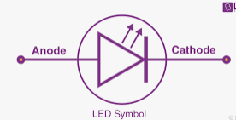
Light-emitting Diode: (LED)
LED Symbol
The LED symbol is similar to a diode symbol except for two small arrows that specify the emission of light, thus it is called LED (light-emitting diode).
The LED includes two terminals namely anode (+) and the cathode (-). The LED symbol is shown below.

Slide 16
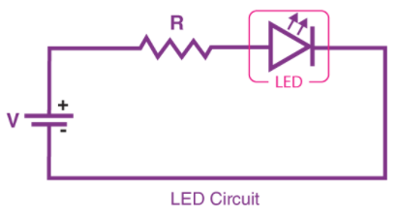
Light-emitting Diode: (LED)
Simple LED Circuit
The circuit consists of a LED, a voltage supply and a resistor to regulate the current and voltage.

Slide 17
Light-emitting Diode: (LED)
Construction of LED
The LED is designed through the deposition of three semiconductor material layers over a substrate.
These three layers are arranged one by one; the top region is P-type region, the middle region (depletion region) is active and finally, the bottom region is N-type.
The P-type region includes the holes; the N-type region includes elections whereas the active region includes both holes and electrons.
When the voltage is not applied to the LED, then there is no flow of electrons and holes so they are stable.
Once the voltage is applied then the LED will forward biased, so the electrons in the N-region and holes from P-region will move to the active region.
This active region is also known as the depletion region.

Slide 18
Light-emitting Diode: (LED)
Because the charge carriers like holes include a positive charge whereas electrons have a negative charge so the light can be generated through the recombination of polarity charges.

Slide 19
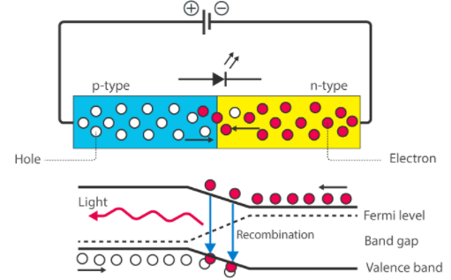
Light-emitting Diode: (LED)
Working Principle of LED

Slide 20
Light-emitting Diode: (LED)
Working Principle of LED
When the diode is forward biased, then the electrons and holes are moving fast across the junction and they are combined constantly, removing one another out.
Soon after the electrons are moving from the n-type to the p-type silicon, it combines with the holes, then it disappears.
Hence, it makes the complete atom & more stable and it gives the little burst of energy in the form of a tiny packet or photon of light.
We call this phenomenon electroluminescence.
Electroluminescence is an optical phenomenon, and electrical phenomenon where a material emits light in response to an electric current passed through it.
As the forward voltage increases, the intensity of the light increases and reaches a maximum.

Slide 21
Light-emitting Diode: (LED)
Types of LED
Miniature LEDs.
High-Power LEDs.
Flash LED.
Bi and Tri-Colour.
Red Green Blue LEDs.
Alphanumeric LED.
Lighting LED

Slide 22
Light-emitting Diode: (LED)
List of Materials Used of Light Emitting Diodes
Gallium Arsenide (GaAs) – infra-red
Gallium Arsenide Phosphide (GaAsP) – red to infra-red, orange
Aluminium Gallium Arsenide Phosphide (AlGaAsP) – high-brightness red, orange-red, orange, and yellow
Gallium Phosphide (GaP) – red, yellow and green
Aluminium Gallium Phosphide (AlGaP) – green
Gallium Nitride (GaN) – green, emerald green
Gallium Indium Nitride (GaInN) – near-ultraviolet, bluish-green and blue.
Silicon Carbide (SiC) – blue as a substrate.
Zinc Selenide (ZnSe) – blue.
Aluminium Gallium Nitride (AlGaN) – ultraviolet

Slide 23
Light-emitting Diode: (LED)
The basic differences between a diode and a LED.
Diode | LED
The semiconductor device, conducts simply in one direction. | The LED is one type of diode, used to generate light.
The diode is designed with a semiconductor material and the flow of electrons in this material can give their energy in heat form. | The LED is designed with the gallium phosphide & gallium arsenide whose electrons can generate light while transmitting the energy.
The diode changes the AC into the DC | The LED changes the voltage into light
It has a high reverse breakdown voltage | It has a low-reverse breakdown voltage.
The on-state voltage of diode is 0.7 v for silicon whereas, for germanium, it is 0.3 v | The on-state voltage of LED approximately ranges from 1.2 to 2.0 V.
The diode is used in voltage rectifiers, clipping & clamping circuits, voltage multipliers. | LED are using in traffic signals, automotive headlamps, in medical devices, camera flashes, etc.

Slide 24
Light-emitting Diode: (LED)
Advantages of Light-emitting Diode:
The cost of LED’s is less and they are tiny.
By using the LED’s electricity is controlled.
The intensity of the LED differs with the help of the microcontroller.
Its has long lifetime.
It is energy efficient.
It does not require warm-up period.
Doesn’t affect by cold temperatures.
Color Rendering is Excellent and environmentally friendly

Slide 25
Light-emitting Diode: (LED)
Disadvantages of Light-emitting Diode:
It is expensive.
Temperature sensitive
Temperature dependence.
Light quality.
Electrical polarity.
Voltage sensitivity
Efficiency drop.
Impact on insects

Slide 26
Light-emitting Diode: (LED)
Applications of Light Emitting Diode
LED is used as a bulb in the homes and industries.
The light-emitting diodes are used in motorcycles and cars.
These are used in mobile phones to display the message.
At the traffic light signals led’s are used.

Slide 27

Organic Light-emitting Diode: (OLED)
What is OLED?
OLED stands for Organic Light Emitting Diode. It is an electronic device made by placing series of organic thin films between the two conductors.
A bright light is emitted when electrical current is being applied.
They are thin-film organic semiconductor light emitting devices.
Here, anode is transparent and made of indium tin oxide.
Cathode is reflective and made of metal.
When an external potential is applied across the electrodes electrons and holes shift inside the material and re-combine to form excitons and consecutively emits photons.

Slide 28
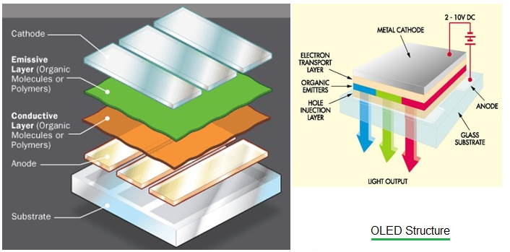
Organic Light-emitting Diode: (OLED)
OLED Structure

Slide 29
Organic Light-emitting Diode: (OLED)
OLED Structure:
OLED structure consists of Cathode, Emissive Layer, Conductive Layer, Anode and substrate.
It uses thin film of organic material sandwiched between two electrodes viz. anode and cathode.
Let us understand constructions and functions of each of these layers of OLED structure.
Substrate: It is made of thin translucent glass or foil material. It functions as base of the OLED structure.
Anode: Its main function is to emit electrons when voltage is applied across its terminals. Hence it is called as emitter.
Organic layer: It contains conductive polymer made of hydrogen or carbon molecules. It is situated above anode layer.

Slide 30
Organic Light-emitting Diode: (OLED)
Conductive layer: It is made of organic plastic molecules. It helps to move holes from the anode.
Emissive layer: It is made of organic materials which are different than used in conductive layer. It helps to transport electrons from the cathode.
Cathode: It is top part of the OLED. It injects electrons when potential difference is applied across its terminals.

Slide 31
Organic Light-emitting Diode: (OLED)
OLED Working Operation:
Due to battery or power supply, voltage is being applied to the OLED.
As a result current flows from cathode to the anode through the organic layers.
This process gives electrons to the emissive layer and removes electrons from conductive layer.
Removal of electrons from conductive layer leave out holes which need to be filled with electrons in emissive layer.
The holes jump to emissive layer and will recombine with electrons.
As electrons drop into holes, they release their extra energy as light.
This way light emission takes place in the OLED device.

Slide 32
Organic Light-emitting Diode: (OLED)
OLED Types
Based on number of layers OLEDs can be classified into two types:
Two layer OLED;
three layer OLED.
Two Layer OLEDs: Electrons are injected from cathode into lowest unoccupied molecular orbital. Simultaneously holes are injected from anode into highest occupied molecular orbital.
Three layer OLEDs: the conductive layer is replaced with electron transport layer and hole transport layer.
Classification Based on working, features and applications:
PMOLED (Passive Matrix OLED)
AMOLED (Active Matrix OLED)
TOLED (Transparent OLED)
FOLED (Foldable OLED)
White OLED and Top Emitting OLED

Slide 33
Organic Light-emitting Diode: (OLED)
Advantages of OLED:
The OLEDs are flexible and hence it is very easy to manufacture OLED displays or other OLED devices such as mobile phones, cameras, wearable devices etc.
They use wide energy gap semiconductors and exhibit singlet and triplet exciton radiation phenomenon compare to LEDs and LCDs.
OLED consumes less power and are suitable for devices requiring less power consumption such as android phones, portable gaming consoles, media players, digital cameras etc..
It provides remarkable color constancy, high efficiency and operational stability.
They are very thin and small in size and hence, are light in weight.

Slide 34
Organic Light-emitting Diode: (OLED)
Disadvantages of OLED:
Their lifetime is shorter compare to other display types.
White, Red and Green OLED offer lifetime of about 5 to 25 years whereas, blue OLED offers about 1.6 years.
It is expensive compare to LCD.
It is susceptible to water and hence it can be easily damaged by water.
OLED screens are even worse compare to LCD when subjected to direct sunlight.
Overall luminance degradation.
Limited market availability.

Slide 35
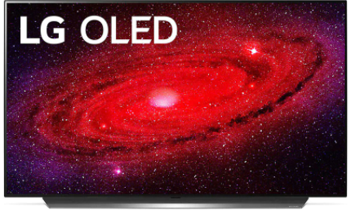
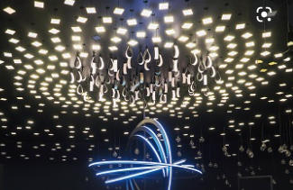
Organic Light-emitting Diode: (OLED)
Applications of OLED:
OLED devices for televisions and computer monitors.
Smartphones and Tablets.
Wearables.
Light Panels.
OLED Materials from Avantama (Avantama is a specialist nanomaterials and electronics manufacturer).
Media players, digital cameras, portable gaming consoles and mini-screens.

